Slide 1
Technology, Screen Time, and Their Effects on Mental Health
Nisa Kan 31999

Slide 2
MY DATASET
User_ID: Anonymized unique identifier
Age & Gender: Demographic information
Technology_Usage_Hours: Daily time spent using digital devices
Social_Media_Usage_Hours: Hours spent specifically on social media
Gaming_Hours: Time spent playing games on a daily basis
Screen_Time_Hours: Total screen exposure per day
Sleep_Hours: Daily sleep duration in hours
Stress_Level: Self-reported (Low, Medium, High) → converted to numerical scale (1–3)
Mental_Health_Status: General mental well-being status (e.g., stable, moderate, struggling)
Physical_Activity_Hours: Exercise or active hours per day
Support_Systems_Access: Whether the individual has access to emotional or social support
Work_Environment_Impact: How work setting affects stress (e.g., high-pressure, balanced)
Online_Support_Usage: Use of digital tools or communities for mental support

Slide 3
HYPOTHESIS
Null Hypothesis (H₀):
There is no correlation between screen time and stress or sleep duration.
Alternative Hypothesis (H₁):
There is a correlation between screen time and sleep hours.

Slide 4
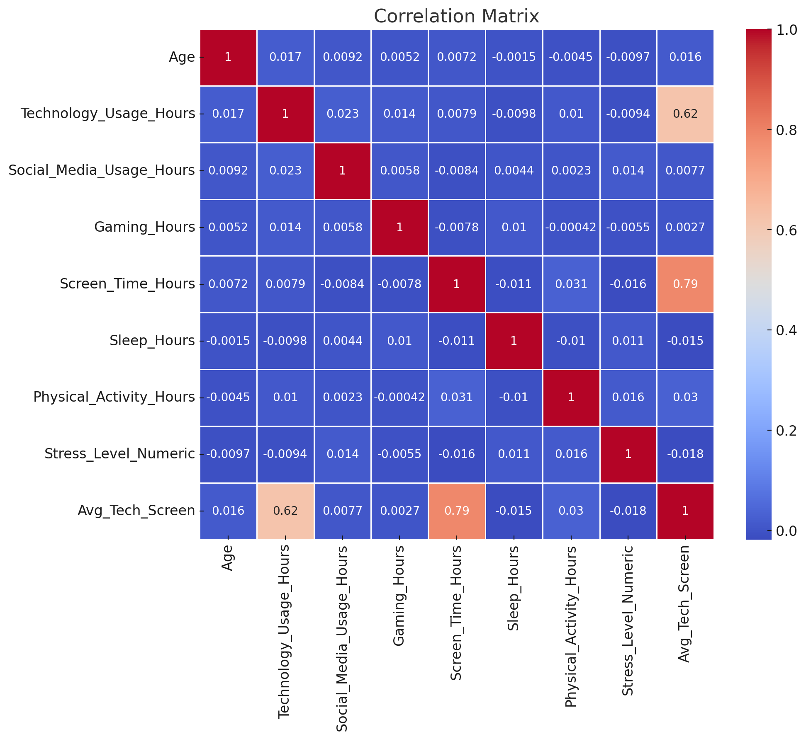
MULTIVARIATE ANALYSIS
Correlation Heatmap
There is little to no strong linear correlation between screen time, technology usage, and sleep hours. However, a slight negative association is visible between screen time and sleep, suggesting that as screen time increases, sleep hours slightly decrease, although the relationship is weak.

Slide 5
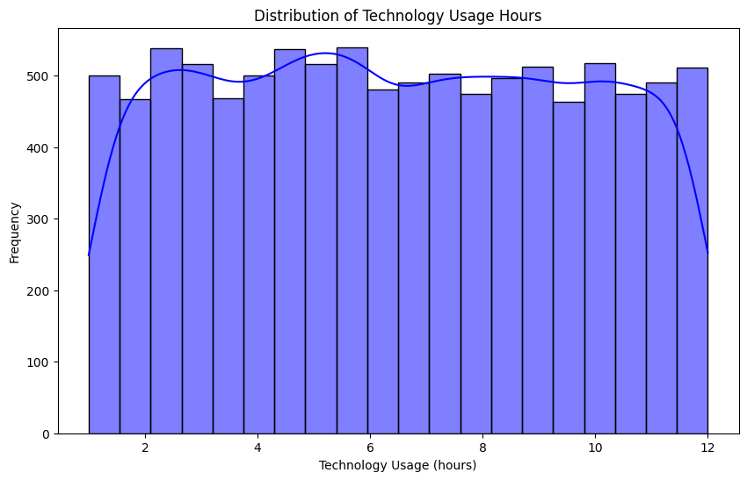
UNIVARIATE ANALYSIS
Technology Usage Histogram
Most individuals use technology for around 2 to 6 hours daily, with the distribution showing a slight right skew. This indicates that while the majority use technology for moderate hours, there are some heavy users who exceed 8 hours.

Slide 6
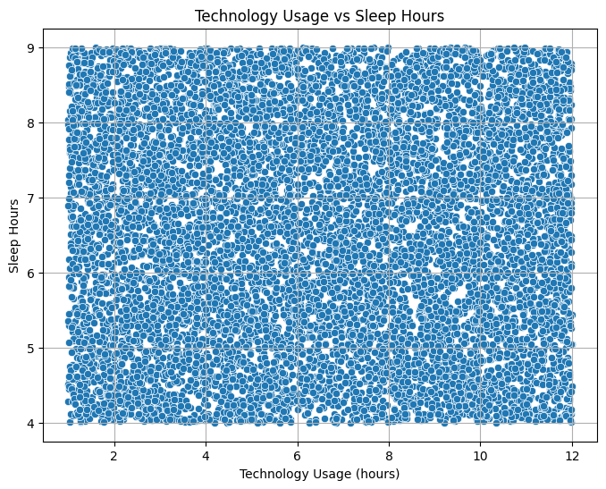
TECHOLOGY USAGE VS SLEEP HOURS
There is no clear trend in the data. However, a weak negative pattern suggests that higher technology usage may slightly reduce sleep duration, with most values scattered without a strong correlation.

Slide 7
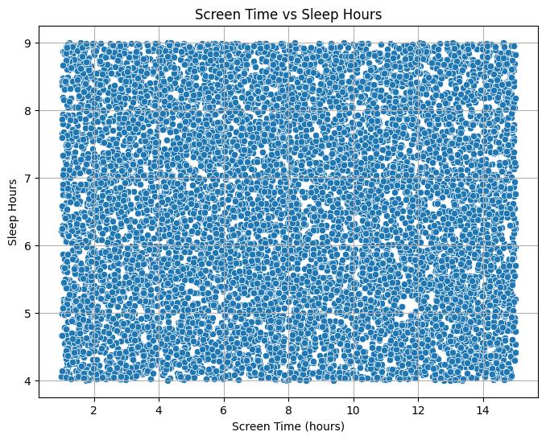
SCREEN TIME VS SLEEP HOURS
Similar to technology usage, screen time seems to be mildly inversely related to sleep hours. However, the relationship is not strong enough to be considered statistically significant, as the data is widely scattered without a clear trend.

Slide 8
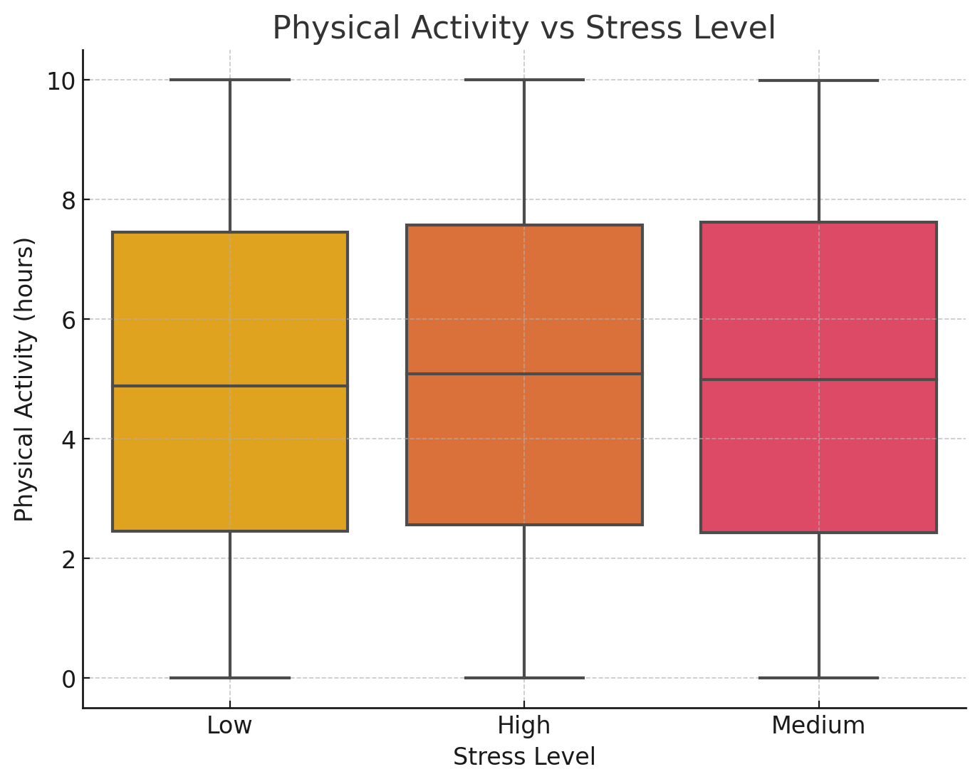
BIVARIATE ANALYSIS
Physical Activity vs Stress Level
Individuals with lower stress levels tend to report higher levels of physical activity, while highly stressed individuals show lower activity ranges.

Slide 9
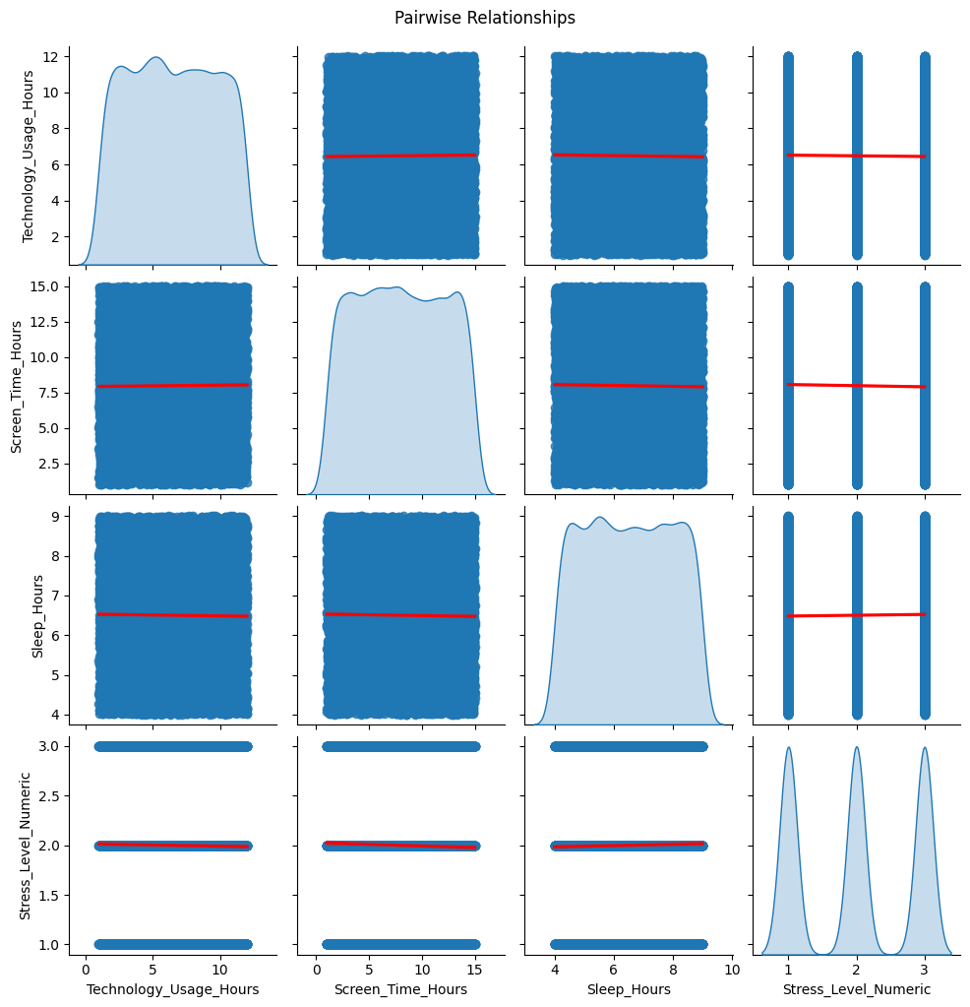
PAIRPLOT
The pairwise relationships show limited variation in Stress Level Numeric and Sleep Hours, while Technology Usage Hours and Screen Time Hours vary widely but don't show a clear relationship. Sleep hours remain consistent across different technology usage patterns.

Slide 10
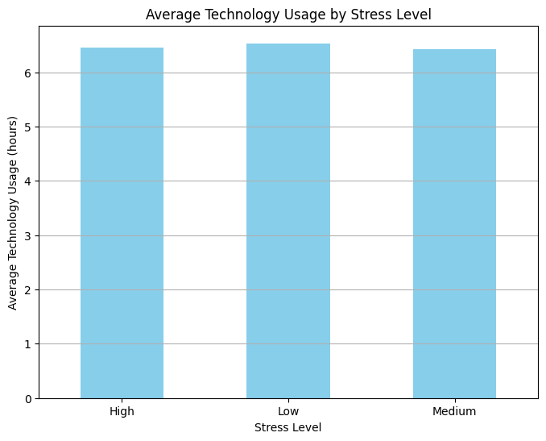
UNIVARIATE ANALYSIS
Average Tech Usage by Stress Level
The average technology usage remains consistent across all stress levels (high, medium, and low), with individuals spending approximately 6 hours on average regardless of their stress level. This suggests no significant difference in technology usage based on stress levels.

Slide 11
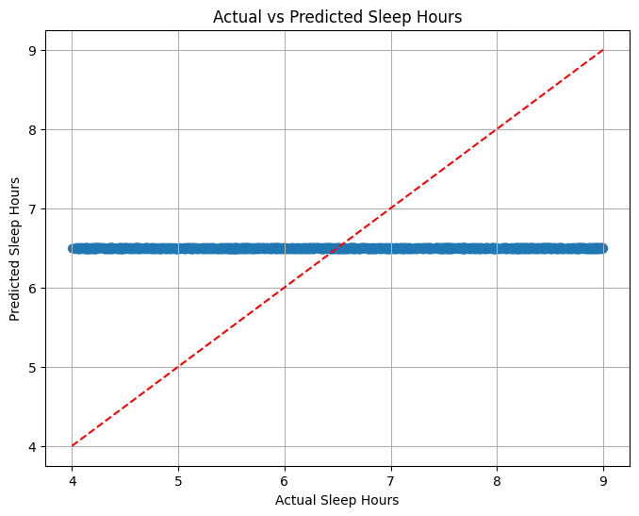
REGRESSION ANALYSIS
ML - Mean Squared Error (MSE): 2.11
The plot shows that the predicted sleep hours are very close to the actual sleep hours, with most points aligning along the red dashed line. This indicates a good fit between the predicted and actual values, suggesting the model is accurately predicting sleep hours.

Slide 12
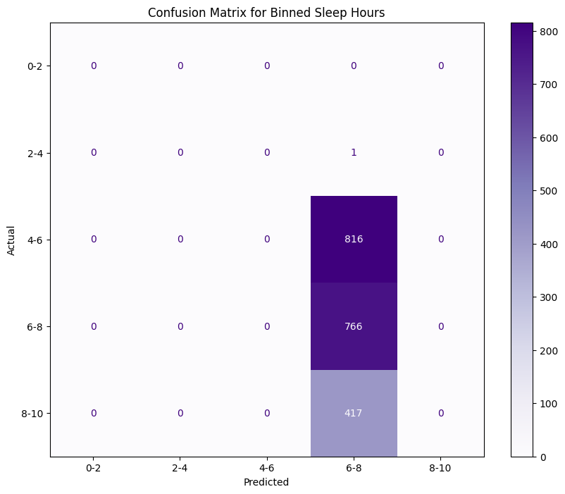
CONFUSION MATRIX FOR BINNED SLEEP HOURS
The confusion matrix shows how well the model predicted binned sleep hours. Most of the predicted values fall within the 6-8 hour range, with a large number of actual sleep hours also in that range (816 instances). There are fewer instances in the other bins, suggesting that the model is quite accurate for the 6-8 hour sleep range.

Slide 13
CONCLUSION
Pearson correlation = -0.01, p-value = 0.2636 We fail to reject the null hypothesis. No statistically significant relationship was found.

